Slide 1
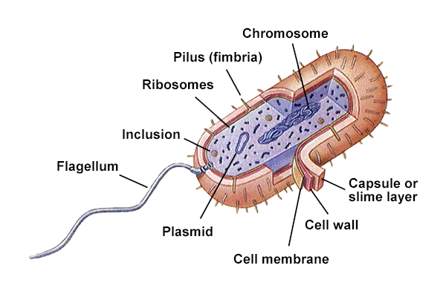
Bacteria structure and Morphoogy
Dr. Sonal Mishra

Slide 2
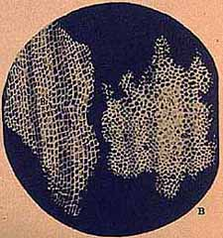
Robert Hooke
(1635-1703)
English Scientist
First to use the microscope to observe cells
Coined the term “cell”

Slide 3
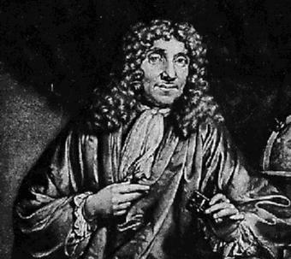
Anton van Leeuwenhoek
1632-1723
Dutch scientist
Invented the first compound microscope
First to observe LIVING cells
Blood cells and protists

Slide 4
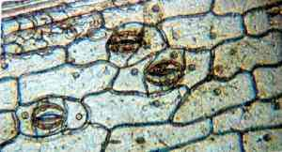
Robert Brown
1773-1858
Scottish botanist
In 1831 he was the first person to observe the nucleus of a cell

Slide 5
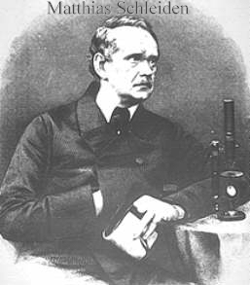
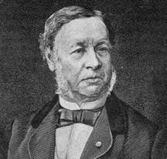
Schleiden & Schwann
1804-1881 1810-1882

Slide 6
Developing Cell Theory
1838
Schleiden
Said “all plants are made up of cells”
Schwann
Said “all animals are made up of cells”

Slide 7
Cell Theory Overview
All organisms are made of one or more cells [Unicellular or Multicellular].
All cells carry on life activities.
New cells arise only from other living cells.

Slide 8
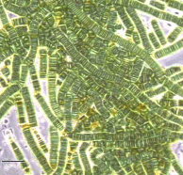
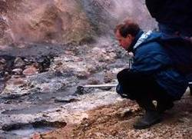
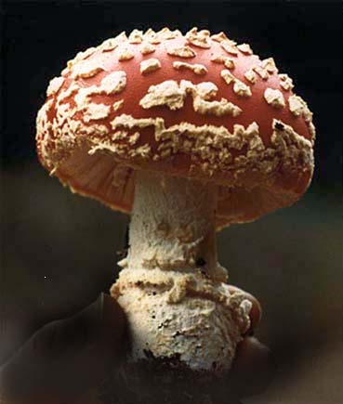
Three Domains of Life
Bacteria- Cyanobacteria and eubacteria
Archaea – prokaryotes living in extreme habitats
Eukarya – Protozoans, fungi, plants, & animals

Slide 9
Characteristics of Bacteria

Slide 10
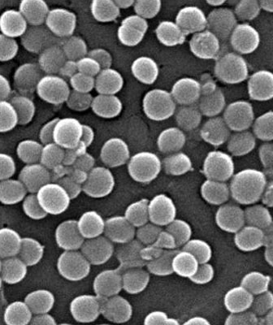
Domain Bacteria
Kingdom Eubacteria
Found just about everywhere
Strong cell walls w/ peptidoglycan
Some have a secondary cell wall

Slide 11
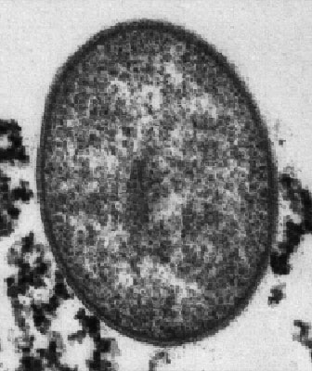
Domain Archaea
Kingdom Archaebacteria
Live in extreme and hostile environments
Has ribosomal proteins similar to eukaryotic cells
Cell walls lack peptidoglycans

Slide 12
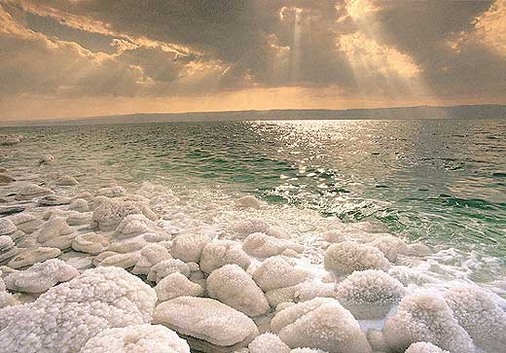
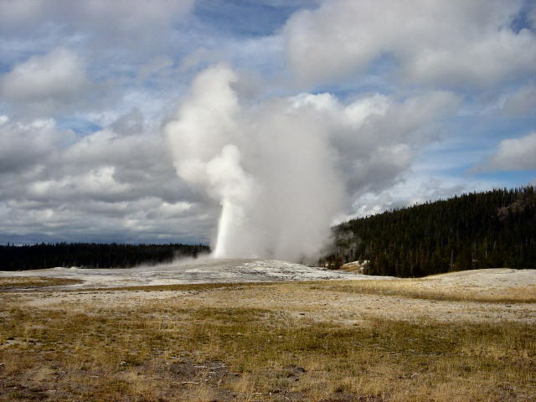
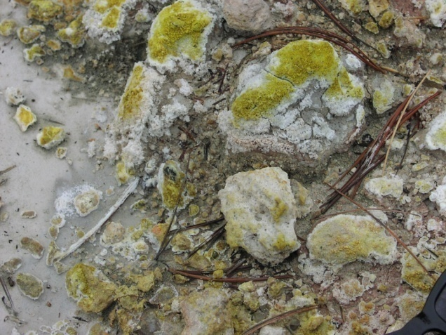
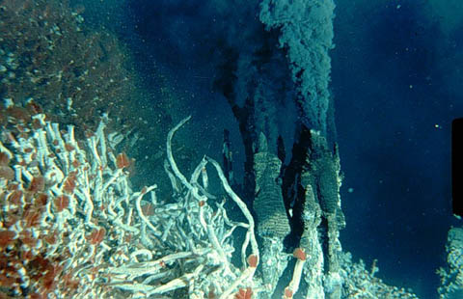
Archaebacteria

Slide 13
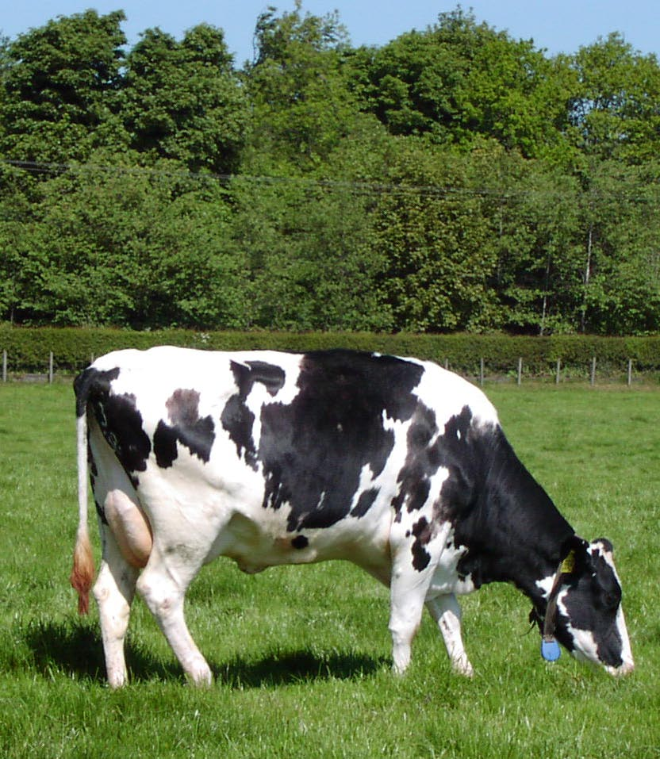
Methanogens
Break down cellulose in a cow’s stomach
Produce marsh (methane) gas

Slide 14
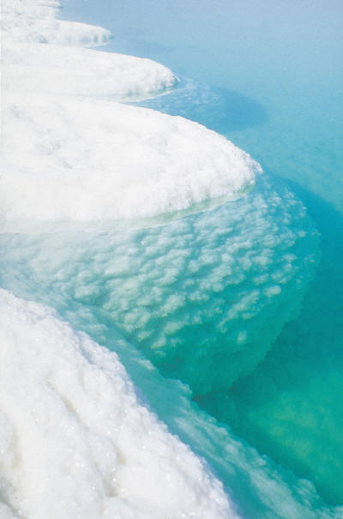
Extreme Halophiles
Live in very salty water
Use salt to generate ATP (energy)
Dead Sea, Great Salt Lake inhabitants

Slide 15

Thermoacidophiles or Thermophiles
Live in extremely hot environments
Found in volcanic vents, hot springs, cracks on ocean floor that leak acid

Slide 16
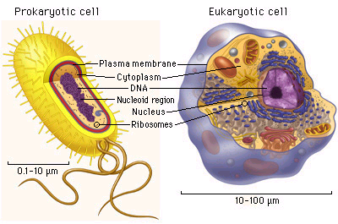
Prokaryotic & Eukaryotic Cells

Slide 17
Prokaryotic vs Eukaryotic
PROKARYOTIC
Simplest form
Lack membrane bound structures
Lack true nucleus
Example: bacteria and cyanobacteria
EUKARYOTIC
Most common
Possess membrane bound structures and a nucleus
Found in most living things

Slide 18
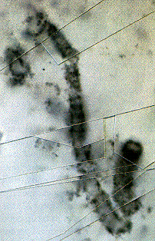
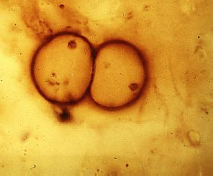
Earliest Prokaryotes
Most numerous organisms on Earth
Include all bacteria
Earliest fossils date 2.5 billion years old

Slide 19
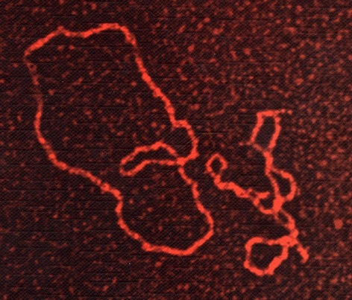
Bacterial Structure
Microscopic
Do not have a nucleus or membrane-bound organelles
Have ribosomes
Single, circular chromosome
Have plasmids
Unicellular
PLASMIDS

Slide 20
Bacterial Cell Structures & Functions
Pili

Slide 21
Bacterial Structure

Slide 22
Bacterial Structure
Cell wall
flagella
cytoplasm
plasmid
Cell membrane
capsule
Strand of DNA

Slide 23
Bacterial Cell Structure
Appendages - flagella, pili or fimbriae
Surface layers - capsule, cell wall, cell membrane
Cytoplasm - nuclear material, ribosome, mesosome, inclusions etc.
Special structure - endospore

Slide 24
Structure of Bacteria
The structure of bacteria is known for its simple body design. Bacteria are single-celled microorganisms with the absence of the nucleus and other cell organelles hence, they are classified as prokaryotic organisms.
Bacteria (the singular is a bacterium) are single cell organisms that can live in different media.
Unicellular organisms belonging to the prokaryotic group where the organisms lack a few organelles and a true nucleus”.

Slide 25
Structure of Bacteria- In cross section organised in 4 layers as
1. Extramural layer- this comprises to slime layer and capsule which lie external to cell wall.
2. Surface appendages- This consists of flagella and pili . Structures projects from the cell surface.
3. Cell envelop-consists if cell wall and cytoplasmic membrane
.
4.Cytoplasmic inclusion-Consists of nucleoid, ribosomes, mesosomes ,volatile granules and plasmid.

Slide 26
Flagella
Slime layer
Cytoplasmic membrane
Cell wall
capsule
ribosomes
Nuclear body or nucleoid Cell
Fimbria
mesosome
Fig. Structure of a Typical Bacteria

Slide 27
THANKS

